Slide 1





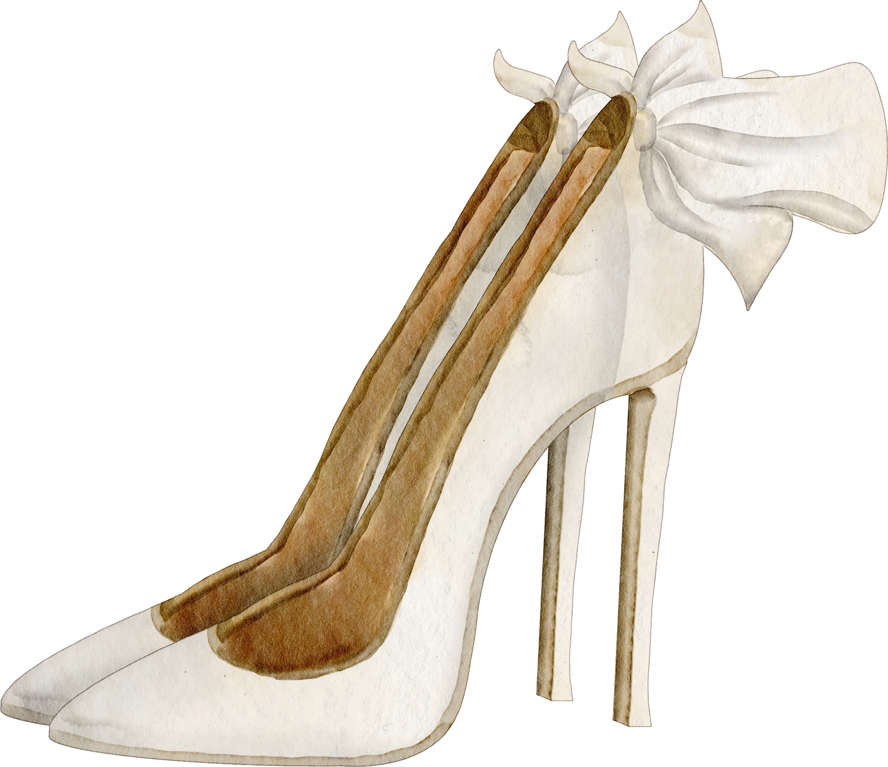




  Miss
  Mrs.
  to
JOIN US FOR BRIDAL SHOWER IN HONOR OF
  Olivia Wilson
OCTOBER
123 ANYWHERE ST, ANY CITY
20
3PM - 5PM
RSVP TO JOY
+123-456-7890

